Slide 1
Plasmon Hybridization in Clusters of Metal Nanoparticles and Magnetic Oligomers
Nicholas P. Montoni
Final Doctoral Exam
Committee Chair: Prof. David Masiello
June 5th, 2018

Slide 2
Nanophotonics

Slide 3
Nanophotonics
Nanotechnology
Photonics

Slide 4
Nanophotonics
Nanotechnology
Photonics
Feynman: “there’s room at the bottom” 1954

Slide 5
Nanophotonics
Nanotechnology
Photonics
Feynman: “there’s room at the bottom” 1954
Taniguchi: “on the basic concept of nanotechnology” 1974

Slide 6
Nanophotonics
Nanotechnology
Photonics
Feynman: “there’s room at the bottom” 1954
Taniguchi: “on the basic concept of nanotechnology” 1974
Drexler: “molecular manufacturing” 1981

Slide 7
Nanophotonics
Nanotechnology
Photonics
(photon electronics)
Feynman: “there’s room at the bottom” 1954
Bell: the photophone
Taniguchi: “on the basic concept of nanotechnology” 1974
Drexler: “molecular manufacturing” 1981

Slide 8
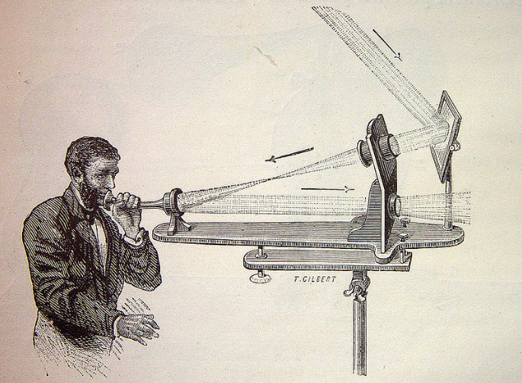
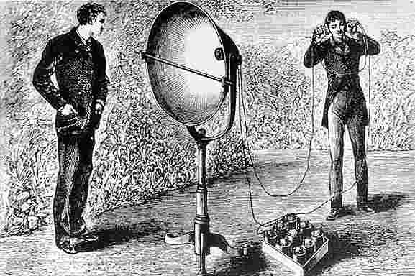
THE PHOTOPHONE

Slide 9
Nanophotonics
Nanotechnology
Photonics
(photon electronics)
Feynman: “there’s room at the bottom” 1954
Bell: the photophone, 1860
Taniguchi: “on the basic concept of nanotechnology” 1974
Mainer: Light Amplification by Stimulated Emission of Radiation (LASER), 1960
Drexler: “molecular manufacturing” 1981

Slide 10
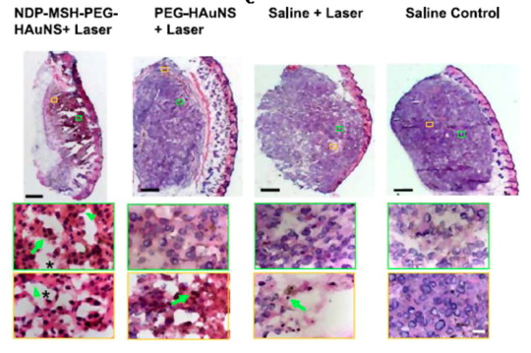
What can nanophotonics do?
Cancer therapy
Huang, X. and El-Sayed, M. A. Alexandria Journal of Medicine. 2011.

Slide 11
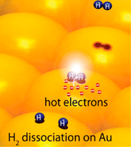
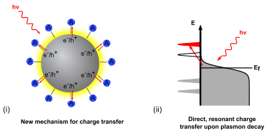
What can nanophotonics do?
Chemical catalysis
N. Halas et al. Nano Lett. 2012.
S. Linic et al. ACS Nano. 2015.

Slide 12
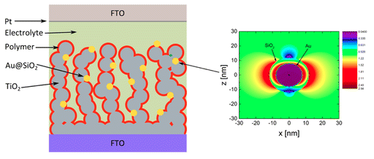
What can nanophotonics do?
Photovoltaic devices
Sanden, S. et al. J. Phys. Chem. C. 2015.

Slide 13
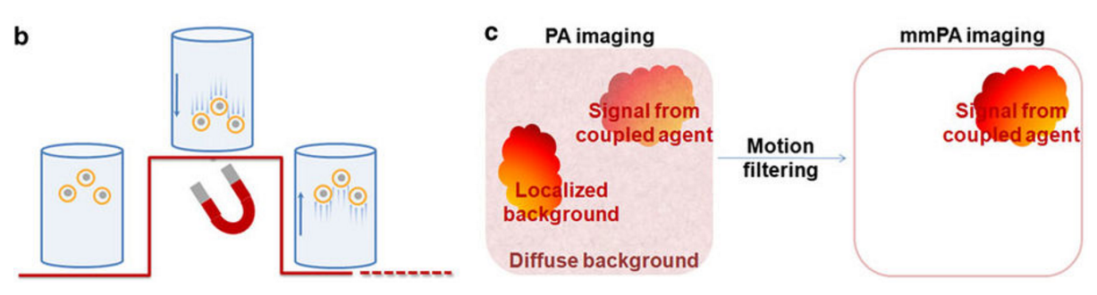
What can nanophotonics do?
Biological sensing and imaging
Jin, Y. et al. Nat. Comm. 2010

Slide 14
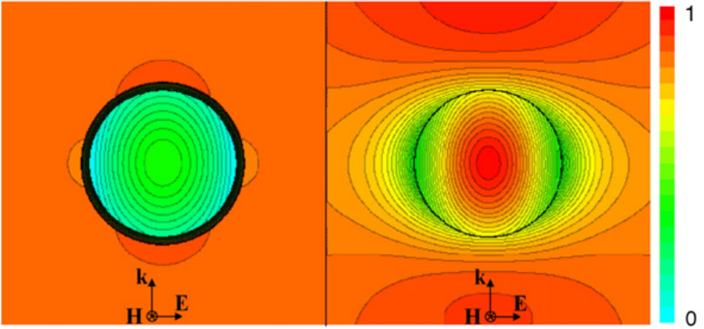
What can nanophotonics do?
Electromagnetic cloaking
Guild, M. et al. Wave Motion 2011

Slide 15
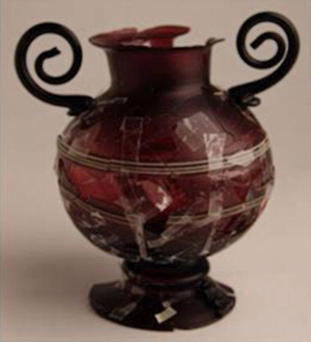
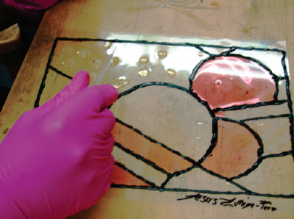
What can nanophotonics do?
The arts!
Ruivo, A. et al. Journal of Cultural Heritage. 2008.
Duncan, K. A., et al. J. Chem. Ed. 2010.

Slide 16
Goals for today:
Learn about plasmons in metal nanoparticles
Learn how plasmons behave in clusters of metal nanoparticles
Qualify and quantify plasmon hybridization in mixed-metal, mixed-geometry clusters
Introduce size and magnetic effects to our model of cluster behavior
Accurately describe the plasmon resonances of large, finite clusters

Slide 17
Metal

Slide 18
Light
Metal

Slide 19
Light
Metal

Slide 20
Light
Metal

Slide 21
Metal
10s of nm
Light
Skin depth

Slide 22
Light
100s of nm
(one half-wavelength)
10s of nm
(Approximately the same size as the skin depth!)

Slide 23
Light
E_{ext}

Slide 24
Light
E_{ext}

Slide 30
Electric dipole plasmon

Slide 31
Light scattering
Electric dipole plasmon decay mechanisms

Slide 32
Light scattering
Electric dipole plasmon decay mechanisms
Local heating

Slide 33
“hot electron” generation
Light scattering
Electric dipole plasmon decay mechanisms
Local heating

Slide 34
An analogy:

Slide 35
An analogy:

Slide 36
An analogy:

Slide 37
An analogy:

Slide 38
An analogy:

Slide 39
An analogy:

Slide 40
An analogy:

Slide 41
An analogy:

Slide 42
The model: one particle
2

Slide 43
Frequency-Dependent Polarizability

Slide 44
Time-Dependent Polarizability and Oscillator Response

Slide 45
Time-Dependent Response of Various Metals

Slide 46
Goals for today:
Learn what a plasmon is and why we should care
Learn how plasmons behave in and clusters of metal nanoparticles
Qualify and quantify plasmon hybridization in mixed-metal, mixed-geometry clusters
Introduce size and magnetic effects to our model of cluster behavior
Accurately describe the plasmon resonances of large, finite clusters

Slide 47
Goals for today:
Learn what a plasmon is and why we should care
Learn how plasmons behave in clusters of metal nanoparticles
Qualify and quantify plasmon hybridization in mixed-metal, mixed-geometry clusters
Introduce size and magnetic effects to our model of cluster behavior
Accurately describe the plasmon resonances of large, finite clusters

Slide 49
Higher-energy, parallel, anti-bonding mode
Energy
Lower-energy, anti-parallel, bonding mode

Slide 50
The model: two particles

Slide 51
The model: two particles
2

Slide 52
A Closer Look at the Coupling Term

Slide 53
A Closer Look at the Coupling Term

Slide 54
A Closer Look at the Coupling Term
Near-field Term

Slide 55
A Closer Look at the Coupling Term
Near-field Term
Intermediate-field Term

Slide 56
A Closer Look at the Coupling Term
Near-field Term
Intermediate-field Term
Far-field Term

Slide 57
A Closer Look at the Coupling Term
Near-field Term
Intermediate-field Term
Far-field Term

Slide 58
Taking the quasistatic limit…

Slide 59
Quasistatic Interactions of a MNP Dimer

Slide 60
Solving coupled oscillator equations of motion
2

Slide 61
Solving coupled oscillator equations of motion

Slide 62
For an arbitrary number of nanoparticles:

Slide 63
Goals for today:
Learn what a plasmon is and why we should care
Learn how plasmons behave in clusters of metal nanoparticles
Qualify and quantify plasmon hybridization in mixed-metal, mixed-geometry clusters
Introduce size and magnetic effects to our model of cluster behavior
Accurately describe the plasmon resonances of large, finite clusters

Slide 64
Goals for today:
Learn what a plasmon is and why we should care
Learn how plasmons behave in clusters of metal nanoparticles
Qualify and quantify plasmon hybridization in mixed-metal, mixed-geometry clusters
Introduce size and magnetic effects to our model of cluster behavior
Accurately describe the plasmon resonances of large, finite clusters

Slide 65
Past and present work
S. C. Quillin, C. Cherqui, N. P. Montoni, G. Li, J. P. Camden, and D. J. Masiello. “Imaging Plasmon Hybridization in Metal Nanoparticle Aggregates Using Electron Energy-Loss Spectroscopy.” J. Phys. Chem. C, 2016.
S. Griffin, N. P. Montoni, G. Li, P. J. Straney, J. E. Millstone, D. J. Masiello, and J. P. Camden. “Imaging Energy Transfer in Pt-Decorated Au Nanoprisms via Electron Energy-Loss Spectroscopy.” J. Phys. Chem. Lett., 2016.
C. Cherqui, Y. Wu, G. Li, S. C. Quillin, J. A. Busche, N. Thakkar, C. West, N. P. Montoni, P. D. Rack, J. P. Camden, and D. J. Masiello. “STEM/EELS Imaging of Magnetic Hybridization in Symmetric and Symmetry-Broken Plasmon Oligomer Dimers and All-Magnetic Fano Interference.” Nano Lett. 2016.
N. Thakkar, N. P. Montoni, C. Cherqui, and D. J. Masiello. “Quantum Plasmon Resonances in Active Environments.” Phys. Rev. B 2018.
N. P. Montoni, S. C. Quillin, C. Cherqui, and D. J. Masiello. “Magnetic Effects in Metal Nanoparticle Arrays.” ACS Photonics, Just Accepted.
N. P. Montoni, J. A. Busche, P. D. Rack, G. Duscher, and D. J. Masiello. “Stimulated Electron Energy-Loss Spectroscopy.” In preparation, 2018.

Slide 66
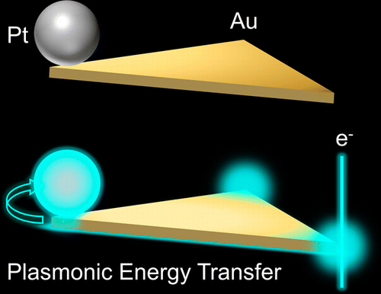
Imaging Energy Transfer in Pt-Decorated Au Nanoprisms via Electron Energy-Loss Spectroscopy
S. Griffin, N. P. Montoni, G. Li, P. J. Straney, J. E. Millstone, D. J. Masiello, and J. P. Camden. J. Phys. Chem. Lett., 2016.

Slide 67
Catalysis – molecules adsorb

Slide 68
Catalysis – molecules collide

Slide 69
Catalysis – molecules react

Slide 70
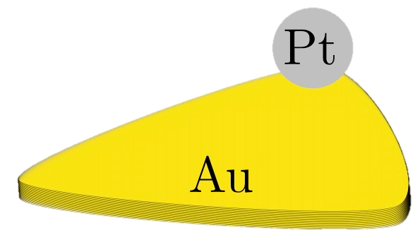
Can we enhance this process?
~ 40-50 nm
Like in a catalytic converter in your car!
~ 150-200 nm

Slide 71
Can we enhance this process?
~ 40-50 nm
~ 150-200 nm

Slide 72
Can we enhance this process?
~ 40-50 nm
~ 150-200 nm

Slide 73
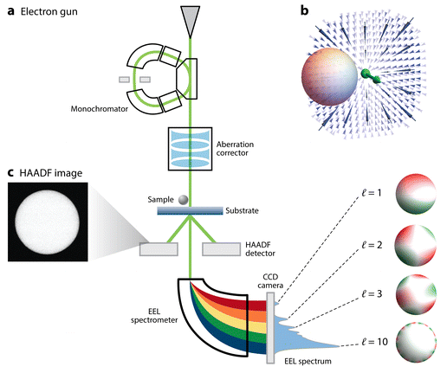
A Quick Intro to Electron Energy-Loss Spectroscopy (EELS)
Cherqui, C., Thakkar, N., Li, G., Camden, J. P., and Masiello, D. J. Annu. Rev. Phys. Chem. 2016.

Slide 74
Generate a spectrum…

Slide 75
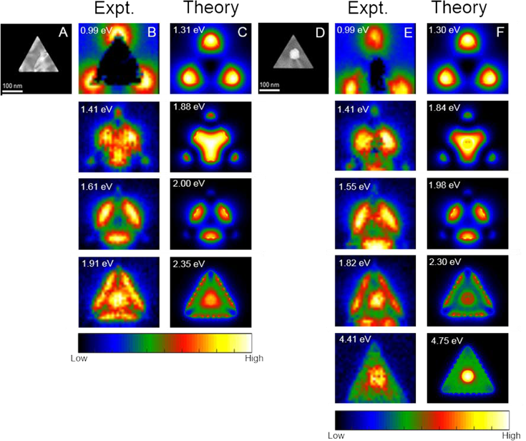
… or generate maps!

Slide 76
A qualitative model of the nanoprism

Slide 77
A qualitative model of the nanoprism

Slide 78
A qualitative model of the nanoprism
This one will be relevant later…

Slide 79
A qualitative model of the nanoprism

Slide 80
A qualitative model of the nanoprism

Slide 81
A qualitative model of the nanoprism

Slide 82
Prism dipole moments
y-directed
x-directed

Slide 83
Adding a (small) perturbation

Slide 84
Adding a (small) perturbation

Slide 85
Adding a (small) perturbation

Slide 86
Experimental (and simulated) evidence

Slide 87
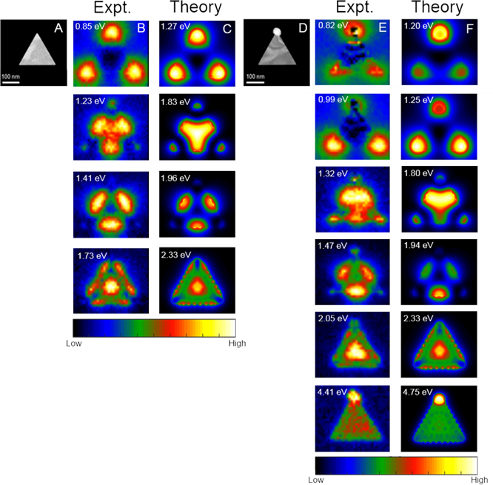
Experimental (and simulated) evidence
Split corner dipole modes!

Slide 88
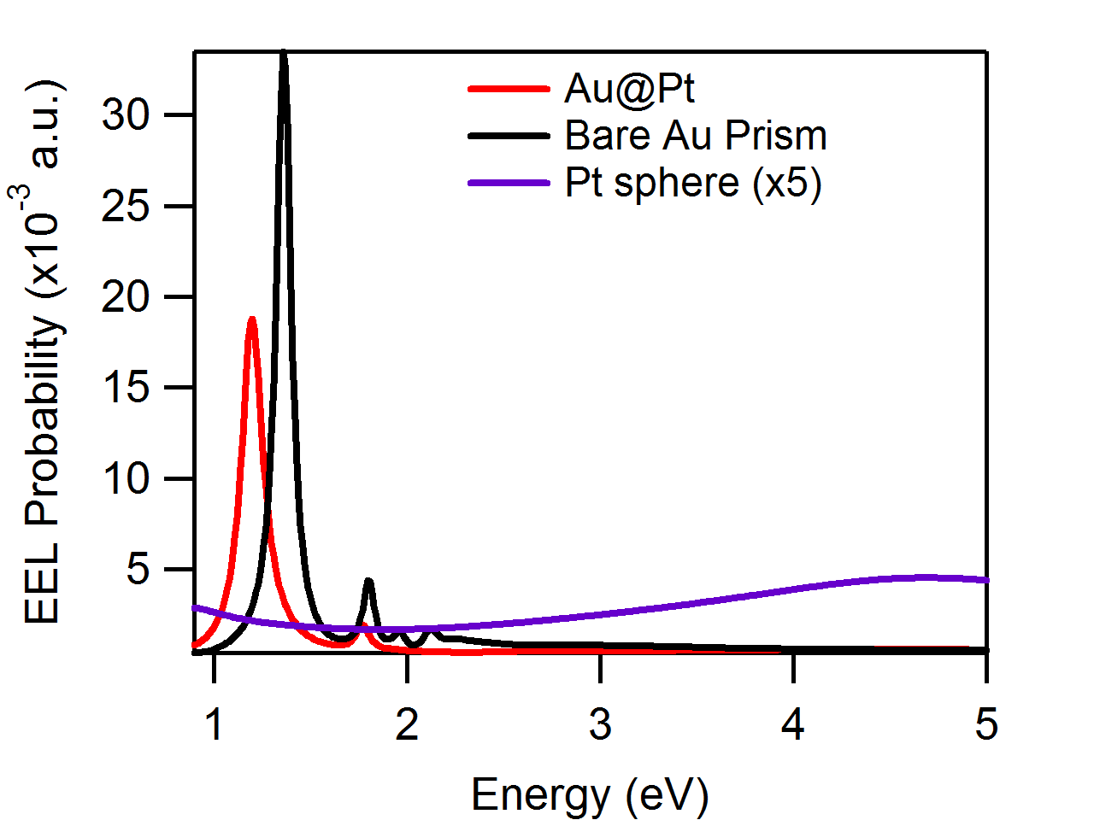
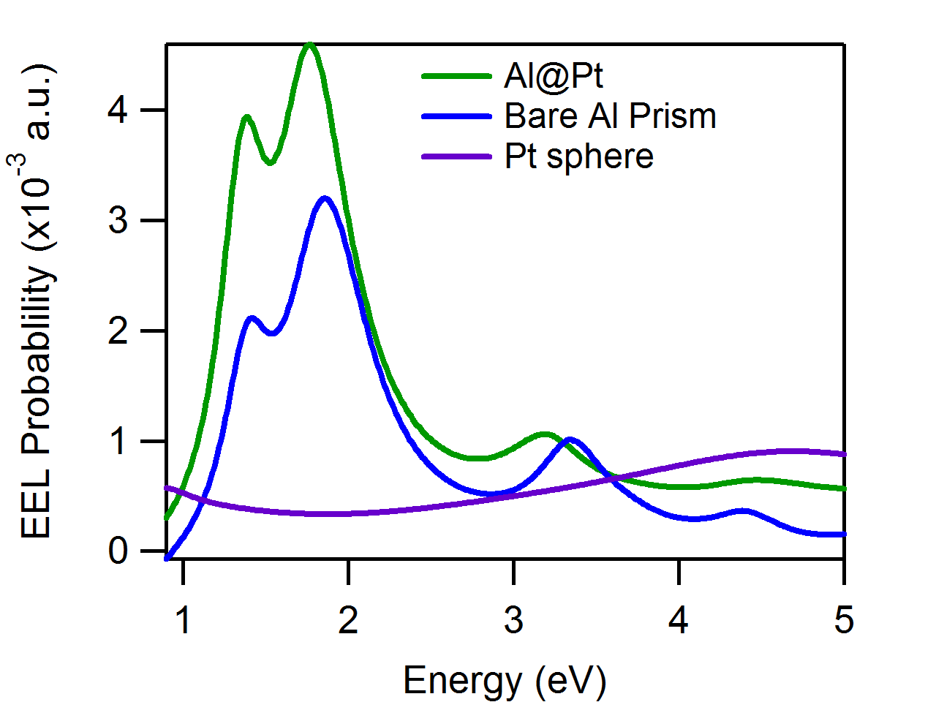
Optimizing the perturbation

Slide 89
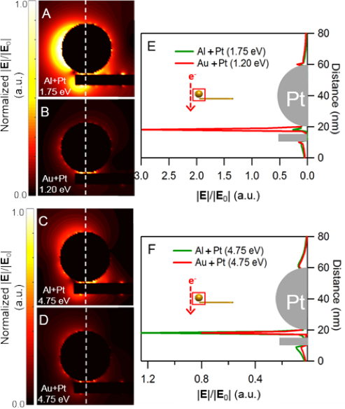
Are electric fields a measure of energy transfer?

Slide 90
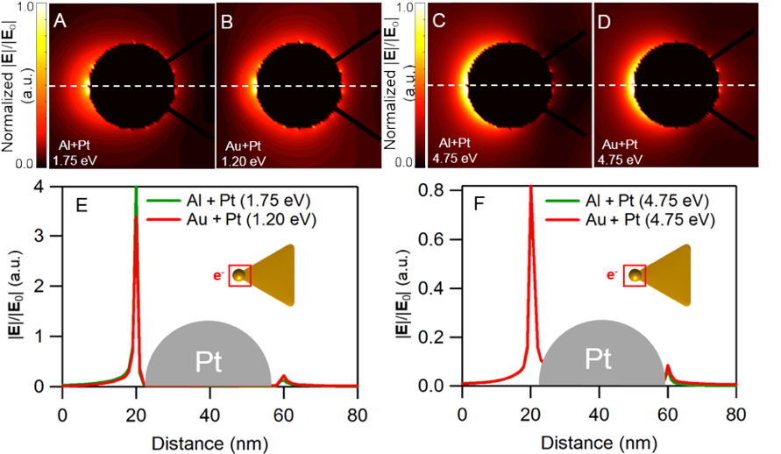
Are electric fields a measure of energy transfer?

Slide 91
What have we learned?
Even a small perturbation has experimentally observable impacts on the plasmonic spectrum of a nanocluster
The strength of the perturbation is location-dependent
Changing the material of one nanoparticle changes the field enhancement around the other

Slide 92
Goals for today:
Learn what a plasmon is and why we should care
Learn how plasmons behave in small particles and clusters of particles
Qualify and quantify plasmon hybridization in mixed-metal, mixed-geometry clusters
Introduce size and magnetic effects to our model of cluster behavior
Accurately describe the plasmon resonances of large, finite clusters

Slide 93
Goals for today:
Learn what a plasmon is and why we should care
Learn how plasmons behave in small particles and clusters of particles
Qualify and quantify plasmon hybridization in mixed-metal, mixed-geometry clusters
Introduce size and magnetic effects to our model of cluster behavior
Accurately describe the plasmon resonances of large, finite clusters

Slide 94
Quasistatic coupling

Slide 95
Fully retarded coupling
Near-field Term
Intermediate-field Term
Far-field Term

Slide 96
Fully Retarded Interaction Energies in a MNP Dimer

Slide 97
Fully Retarded Interaction Energies in a MNP Dimer
Quasistatic
Fully Retarded

Slide 98
Quasistatic Solution

Slide 99
Solutions with Retardation Effects

Slide 100
Solutions with Retardation Effects
The same omega!

Slide 101
Goals for today:
Learn what a plasmon is and why we should care
Learn how plasmons behave in small particles and clusters of particles
Qualify and quantify plasmon hybridization in mixed-metal, mixed-geometry clusters
Introduce size and magnetic effects to our model of cluster behavior
Accurately describe the plasmon resonances of large, finite clusters

Slide 102
Goals for today:
Learn what a plasmon is and why we should care
Learn how plasmons behave in small particles and clusters of particles
Qualify and quantify plasmon hybridization in mixed-metal, mixed-geometry clusters
Introduce size and magnetic effects to our model of cluster behavior
Accurately describe the plasmon resonances of large, finite clusters

Slide 103
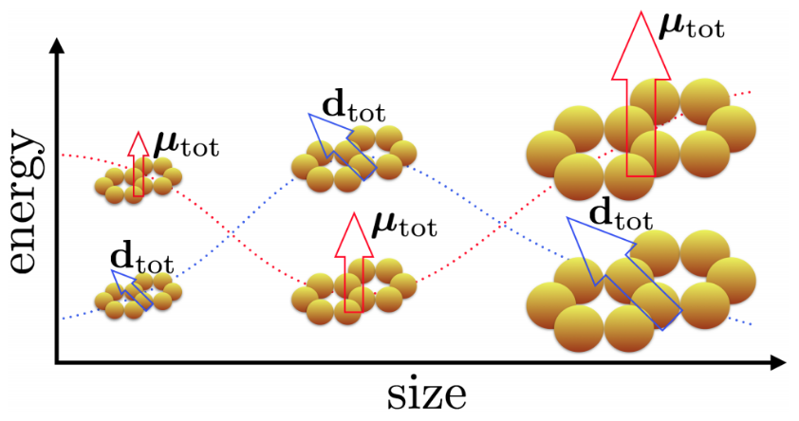
Tunable Spectral Ordering of Magnetic Plasmon Resonances in Metal Nanoparticle Clusters
Montoni N. P., Quillin, S. C., Cherqui, C., and Masiello, D. J. ACS Photonics, Just Accepted.

Slide 104
What does “magnetic” mean?

Slide 105
What does “magnetic” mean?

Slide 106
Cyclic dipoles: like cyclic currents

Slide 107
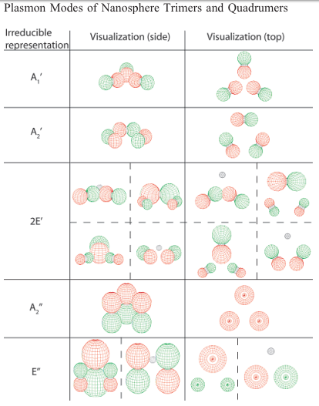
Motivation: Size Dependence
Single-oligomer regime:
Brandl, D. et al. J. Phys. Chem. B 2006.

Slide 108
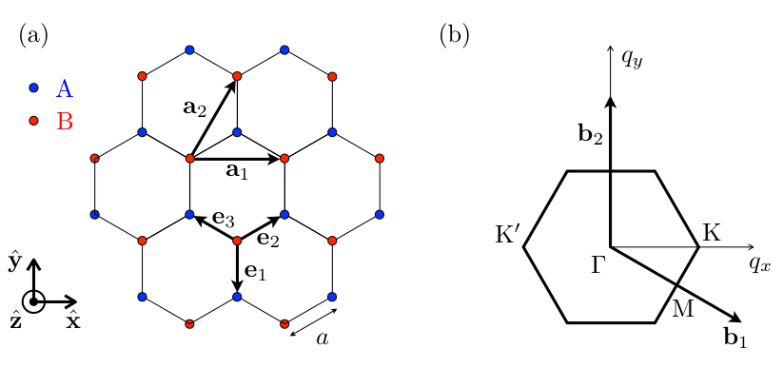
Motivation: Size Dependence
Infinite regime:
Weick, G. et al. Phys. Rev. Lett. 2013

Slide 109
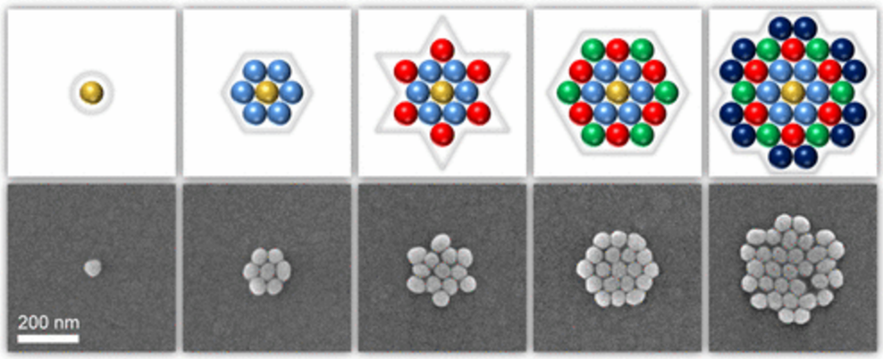
Motivation: Size Dependence
Intermediate size regime:
Greybush, J. et al. ACS Nano 2017

Slide 110
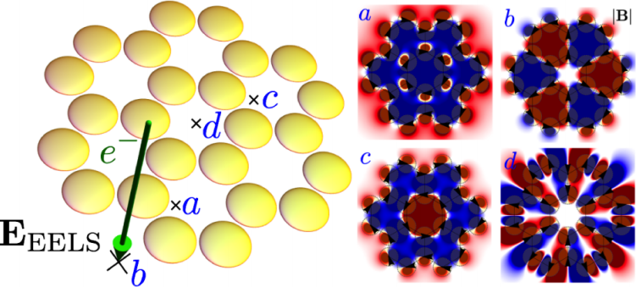
Motivation: Accurate Model
Cherqui, C. et al. ACS Photonics 2014

Slide 111
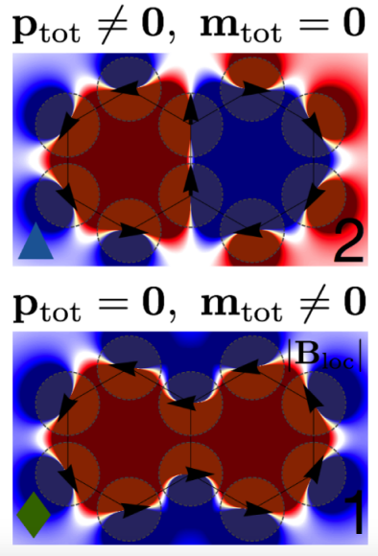
Motivation: Accurate Model
Quasistatic Tight-Binding Model
Energy
Cherqui, C. et al. ACS Photonics 2014

Slide 112
Motivation: Accurate Model
Quasistatic Tight-Binding Model
Full-wave Simulations
Energy
Switch order!
Cherqui, C. et al. ACS Photonics 2014

Slide 113
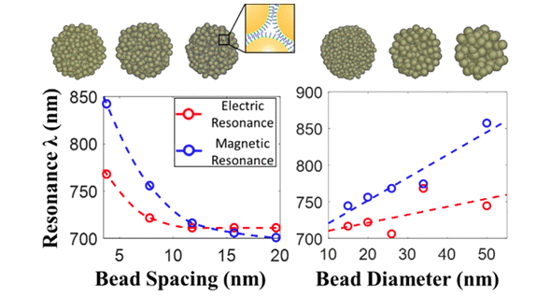
Motivation: Accurate Model
Li, C., Lee, S., Qian, Z., Woods, C., Park, S.-J., and Fakhraai, Z. J. Phys. Chem. C. 2018

Slide 114
Model System: Arrays of Silver Nanospheres

Slide 115
Magnetic Plasmons of the 2-mer and 3-mer

Slide 116
Investigate spectral switching via system size

Slide 117
The size-dependence of magnetic plasmon energetics

Slide 118
The size-dependence of magnetic plasmon energetics

Slide 119
The size-dependence of magnetic plasmon energetics

Slide 120
The size-dependence of magnetic plasmon energetics

Slide 121
Distinguishing the magnetic plasmons

Slide 122
Directional Radiation from Electric and Magnetic Dipole Moments

Slide 123
Directional Radiation from Electric and Magnetic Dipole Moments

Slide 124
Directional Radiation from Electric and Magnetic Dipole Moments

Slide 125
Directional Radiation from Electric and Magnetic Dipole Moments

Slide 126
Directional Radiation from Electric and Magnetic Dipole Moments

Slide 127
Directional Radiation from Electric and Magnetic Dipole Moments

Slide 128
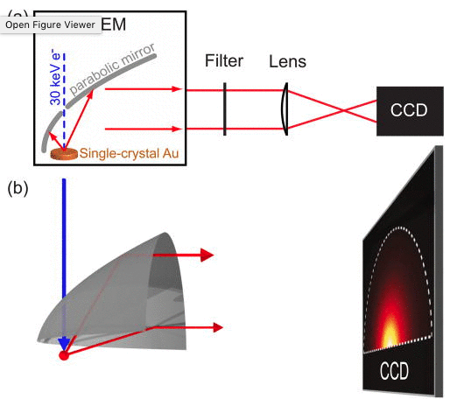
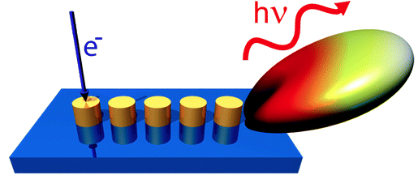
Measuring the angular dependence of scattered light
Coenen, T., Vesseur, E. J. R., Polman, A., and Koenderink, F. Nano Lett. 2011
Coenen, T., Vesseur, E. J. R., and Polman, A. Appl. Phys. Lett. 2011

Slide 129
Angle Resolved CL spectra of magnetic oligomers

Slide 130
Experimentally Relevant Nanoclusters
Greybush, J. et al. ACS Nano 2017

Slide 131
Experimentally Relevant Nanoclusters

Slide 132
Magnetic Plasmon Spectrum of Hexagonally Packed Nanoclusters

Slide 133
Magnetic Plasmon Spectrum of Hexagonally Packed Nanoclusters

Slide 134
Magnetic Plasmon Spectrum of Hexagonally Packed Nanoclusters

Slide 135
Magnetic Plasmon Spectrum of Hexagonally Packed Nanoclusters

Slide 136
Angle Resolved CL of Hexagonally Packed Nanoclusters

Slide 137
Angle Resolved CL of Hexagonally Packed Nanoclusters

Slide 138
Angle Resolved CL of Hexagonally Packed Nanoclusters

Slide 139
Angle Resolved CL of Hexagonally Packed Nanoclusters

Slide 140
What have we learned?
The plasmon spectrum of a cluster of metal nanoparticles depends on MNP size and cluster shape
Without retardation effects, we would never be able to describe the above phenomenon!
Angle-resolved CL is a useful tool for extracting angle-dependent radiative information about metal nanoclusters

Slide 141
Goals for today:
Learn what a plasmon is and why we should care
Learn how plasmons behave in small particles and clusters of particles
Qualify and quantify plasmon hybridization in mixed-metal, mixed-geometry clusters
Introduce size and magnetic effects to our model of cluster behavior
Accurately describe the plasmon resonances of large, finite clusters

Slide 142
Future work: Stimulated Electron Energy-Loss Spectroscopy

Slide 143
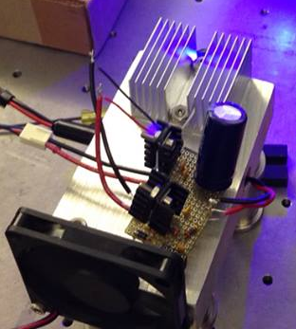
Future work: Stimulated Electron Energy-Loss Spectroscopy

Slide 144
Photon-plasmon and electron-plasmon processes

Slide 145
Photon-plasmon and electron-plasmon processes
absorption

Slide 146
Photon-plasmon and electron-plasmon processes
scattering
absorption

Slide 147
Photon-plasmon and electron-plasmon processes
EELS
e⁻

Slide 148
Photon-plasmon and electron-plasmon processes
EELS
Cathodoluminescence
e⁻

Slide 149
Photon-plasmon and electron-plasmon processes
Electron energy-gain
spectroscopy
e⁻

Slide 150
Photon-plasmon and electron-plasmon processes
Stimulated EELS
e⁻

Slide 151
Photon-plasmon and electron-plasmon processes
Stimulated EELS
e⁻

Slide 152
Stimulated EELS

Slide 153
Stimulated EELS: a few months later…

Slide 154
Stimulated EELS: a few months later…

Slide 155
Extracurriculars Community-Building and Science Advocacy
“Imagine if this type of work was a recognized part of your Ph.D.”
– Dr. Sarah Vorpahl
Founder and President, Out in STEM at UW
Founder, Chemistry Department Mentorship Network
Organizer, Strengthening STEM through Diversity
Organizer, Strategies for Cultivating Inclusion in STEM
Clean Energy Institute Education and Training Fellow
Pacific Science Center Science Communication Fellow
Speaker, 2018 March for Science - Seattle
Husky 100, 2017 Cohort
Secretary, Women in Chemical Sciences (2015-2016)

Slide 156
Acknowledgements
My Doctoral Committee
Prof. David Masiello
Prof. David Ginger
Prof. Sarah Keller
Prof. Elizabeth Nance

Slide 157
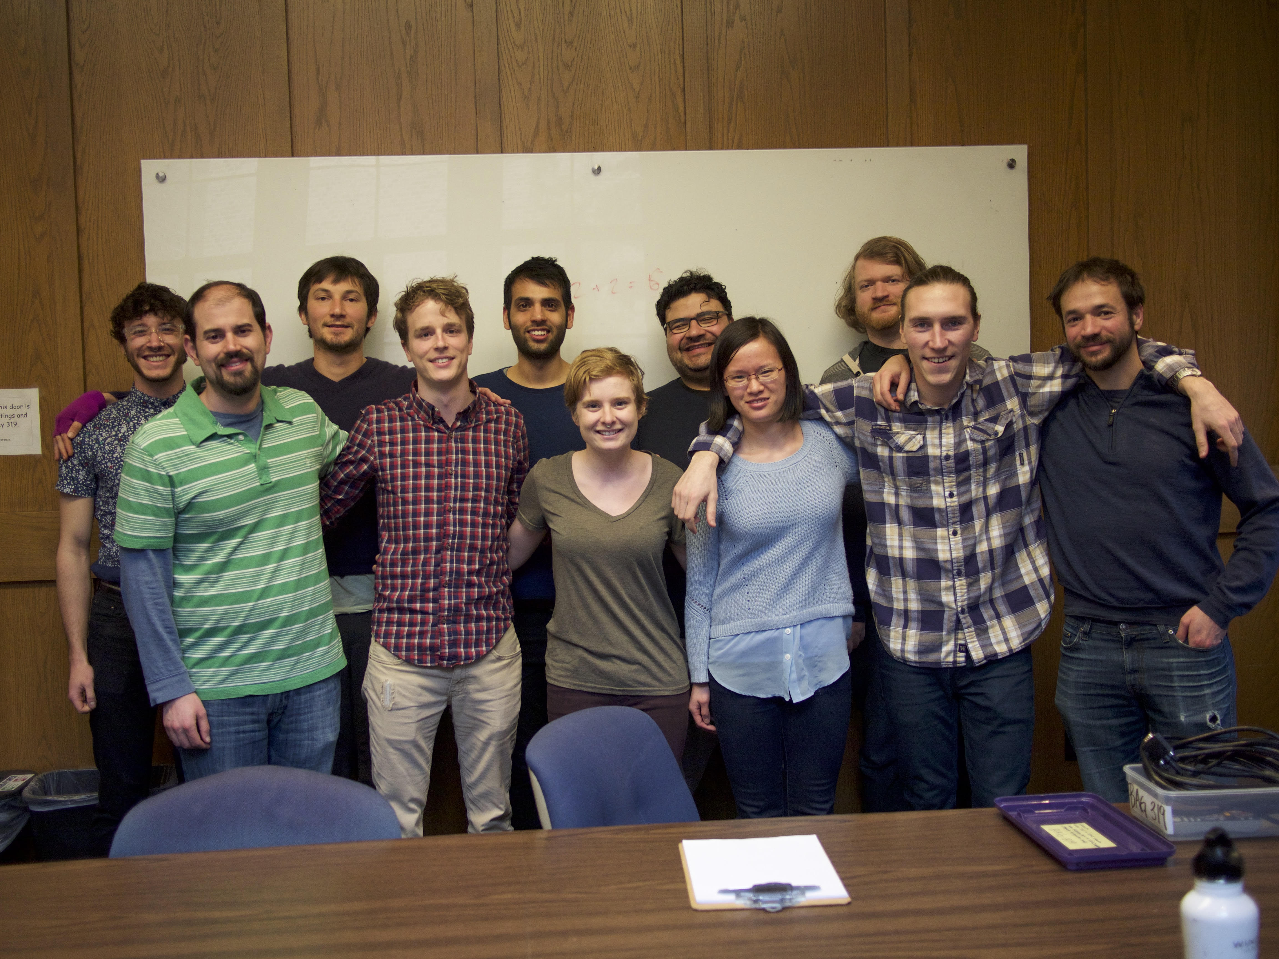
Acknowledgements
The Masiello Group:
Prof. David Masiello
Dr. Charles Cherqui
Dr. Zhaoxia Qian
Dr. Nicholas Bigelow
Dr. Niket Thakkar
Dr. Steven Quillin
Jacob Busche
Harrison Goldwyn
Kevin Smith
Elliot Beutler
Claire West
The Masiello group, March 2017

Slide 158
Acknowledgements
Experimental collaborators

Slide 159
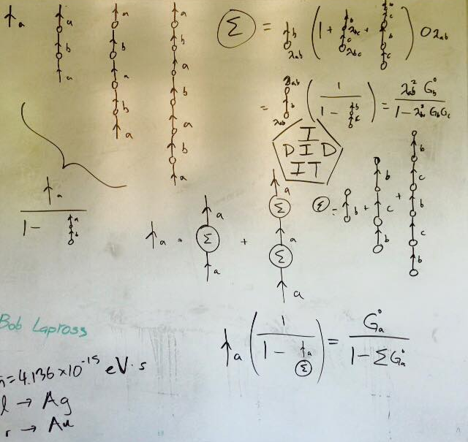
Questions?

Slide 160
EXTRA STUFF

Slide 161
Time-Dependent Response of Various Metals

Slide 162
Time-Dependent Response of Various Metals

Slide 163
Time-Dependent Response of Various Metals

Slide 164
Time-Dependent Response of Various Metals

Slide 166
How I know the quasistatic model doesn’t work at large sizes:

Slide 167
Fully retarded model predicts multiple spectral switches

Slide 168
Oscillations in spacing calculations are due largely to the exponential term

Slide 169
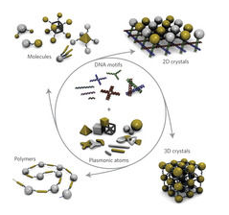
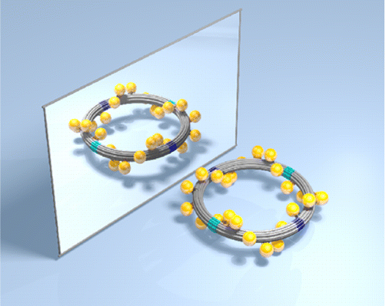
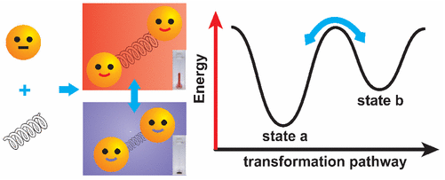
Realistically tunable variable: interparticle distance
Tan, S. et al. Nat. Nanotech. 2011
Urban, M. et al. JACS 2016
Qian,Z. et al. JACS 2017

Slide 170
Spacing: 2-mer
0
10

Slide 171
Spacing: Twomer
Tiny splitting! (< .01 eV)
0
10

Slide 172
Spacing: Twomer
0
10
0
10

Slide 173
Spacing: Twomer
Bigger splitting! (.01 - .1 eV)
0
10

Slide 174
Comparison of Length Scales
Length (nm)
Length (nm)

Slide 175
Conclusions
Magnetic plasmons exhibit tunable spectral ordering
This effect is more pronounced for oligomers with larger constituent particles
0
10

Slide 176
Characteristic Mode Wavelength
Length (nm)
Longest Distance

Slide 177
Characteristic Mode Wavelength
Length (nm)
Longest Distance
Retardation effects become important for this array when it is around ¼ the wavelength of light!

